Slide 1
Chapter 07

Slide 2
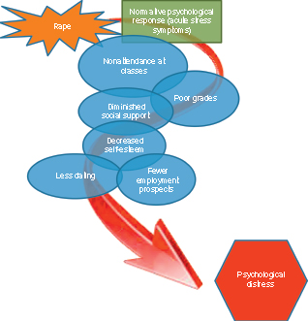
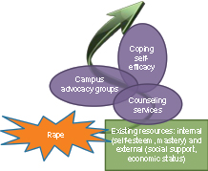
Figure 1 Conceptual illustration of resource loss and gain spirals following a rape.

